Slide 1
Introduction to Mechanical Design & Fabrication

Slide 2





Mechanical Engineering
Heat Transfer
Kinematics
Design
Fluid Mechanics
Mechanics

Slide 3
Mechanics
Design
Stress
Bending
Design for Testing
Design for Improvement
Shear
Inertia
Design for Manufacture
Design for Assembly

Slide 4
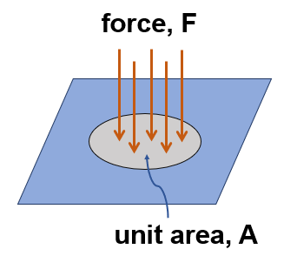
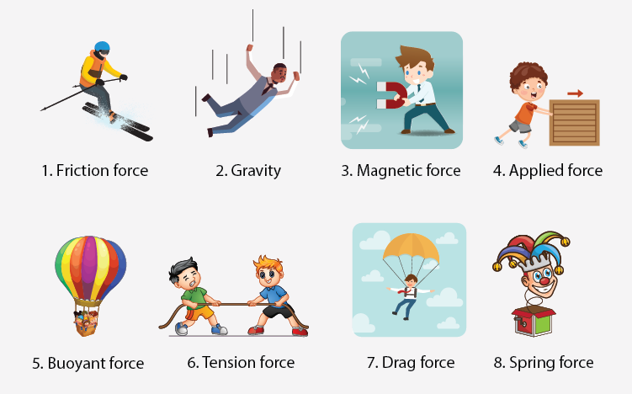
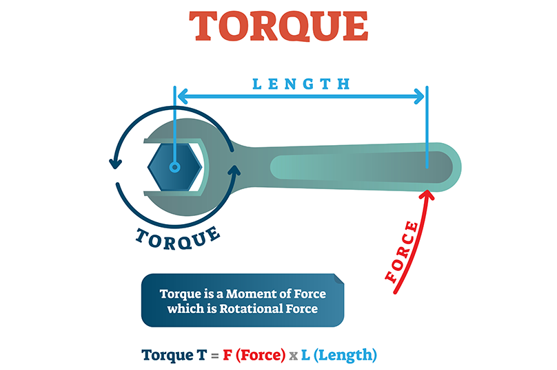
Intro to Forces, Torques, Stresses
Mechanics

Slide 5
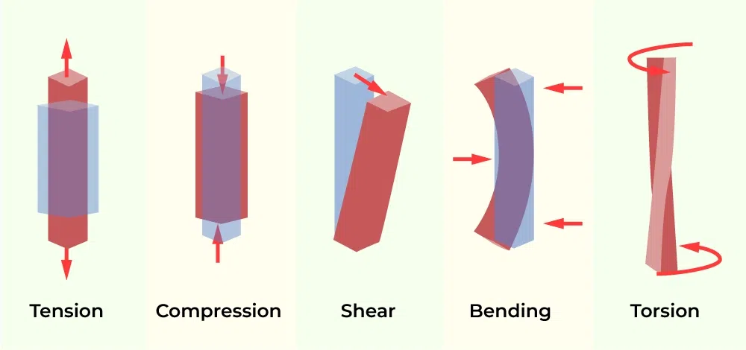
Intro to Forces, Torques, Stresses
Mechanics

Slide 6
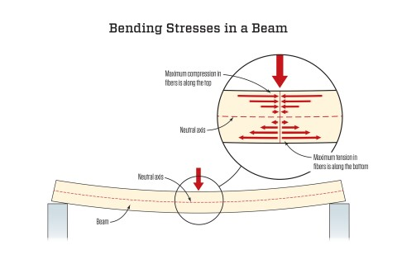
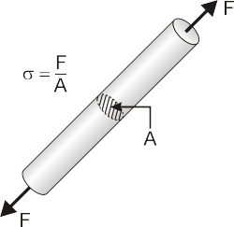
Intro to Forces, Torques, Stresses
Mechanics
Stress
Area = π*radius^2

Slide 7
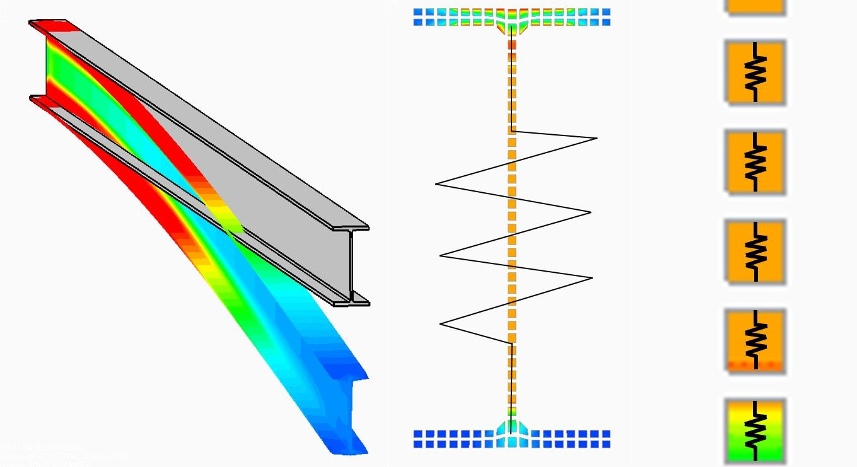
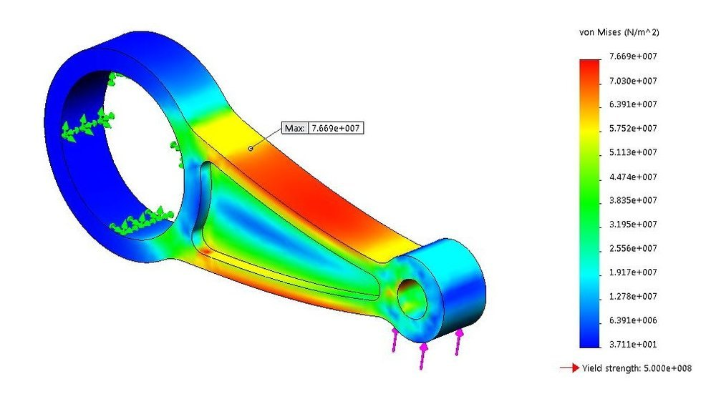
FEA (Finite Element Analysis)
Mechanics
Stress

Slide 8
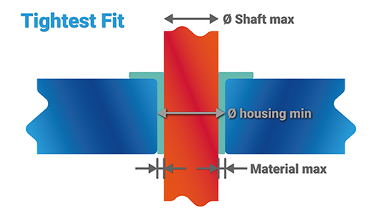
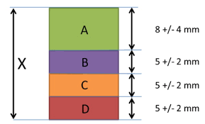
Tolerances
Design For Manufacture & Assembly

Slide 9
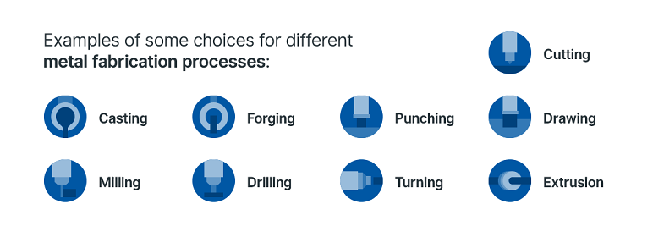
Fabrication

